Slide 1



Slide 2

BUSINESS ANALYTICS Introduction to Business Analytics and Core Business Functions
BUSINESS ANALYSIS Week 3 Lecture: Stakeholder Management

Slide 3
Learning Objectives – WEEK 2
By the end of this lecture you should be able to:
Identify stakeholders in real projects
Understand stakeholder influence & expectations
Use a Power–Interest Matrix
Plan communication like a professional BA
Handle stakeholder conflicts

Slide 4
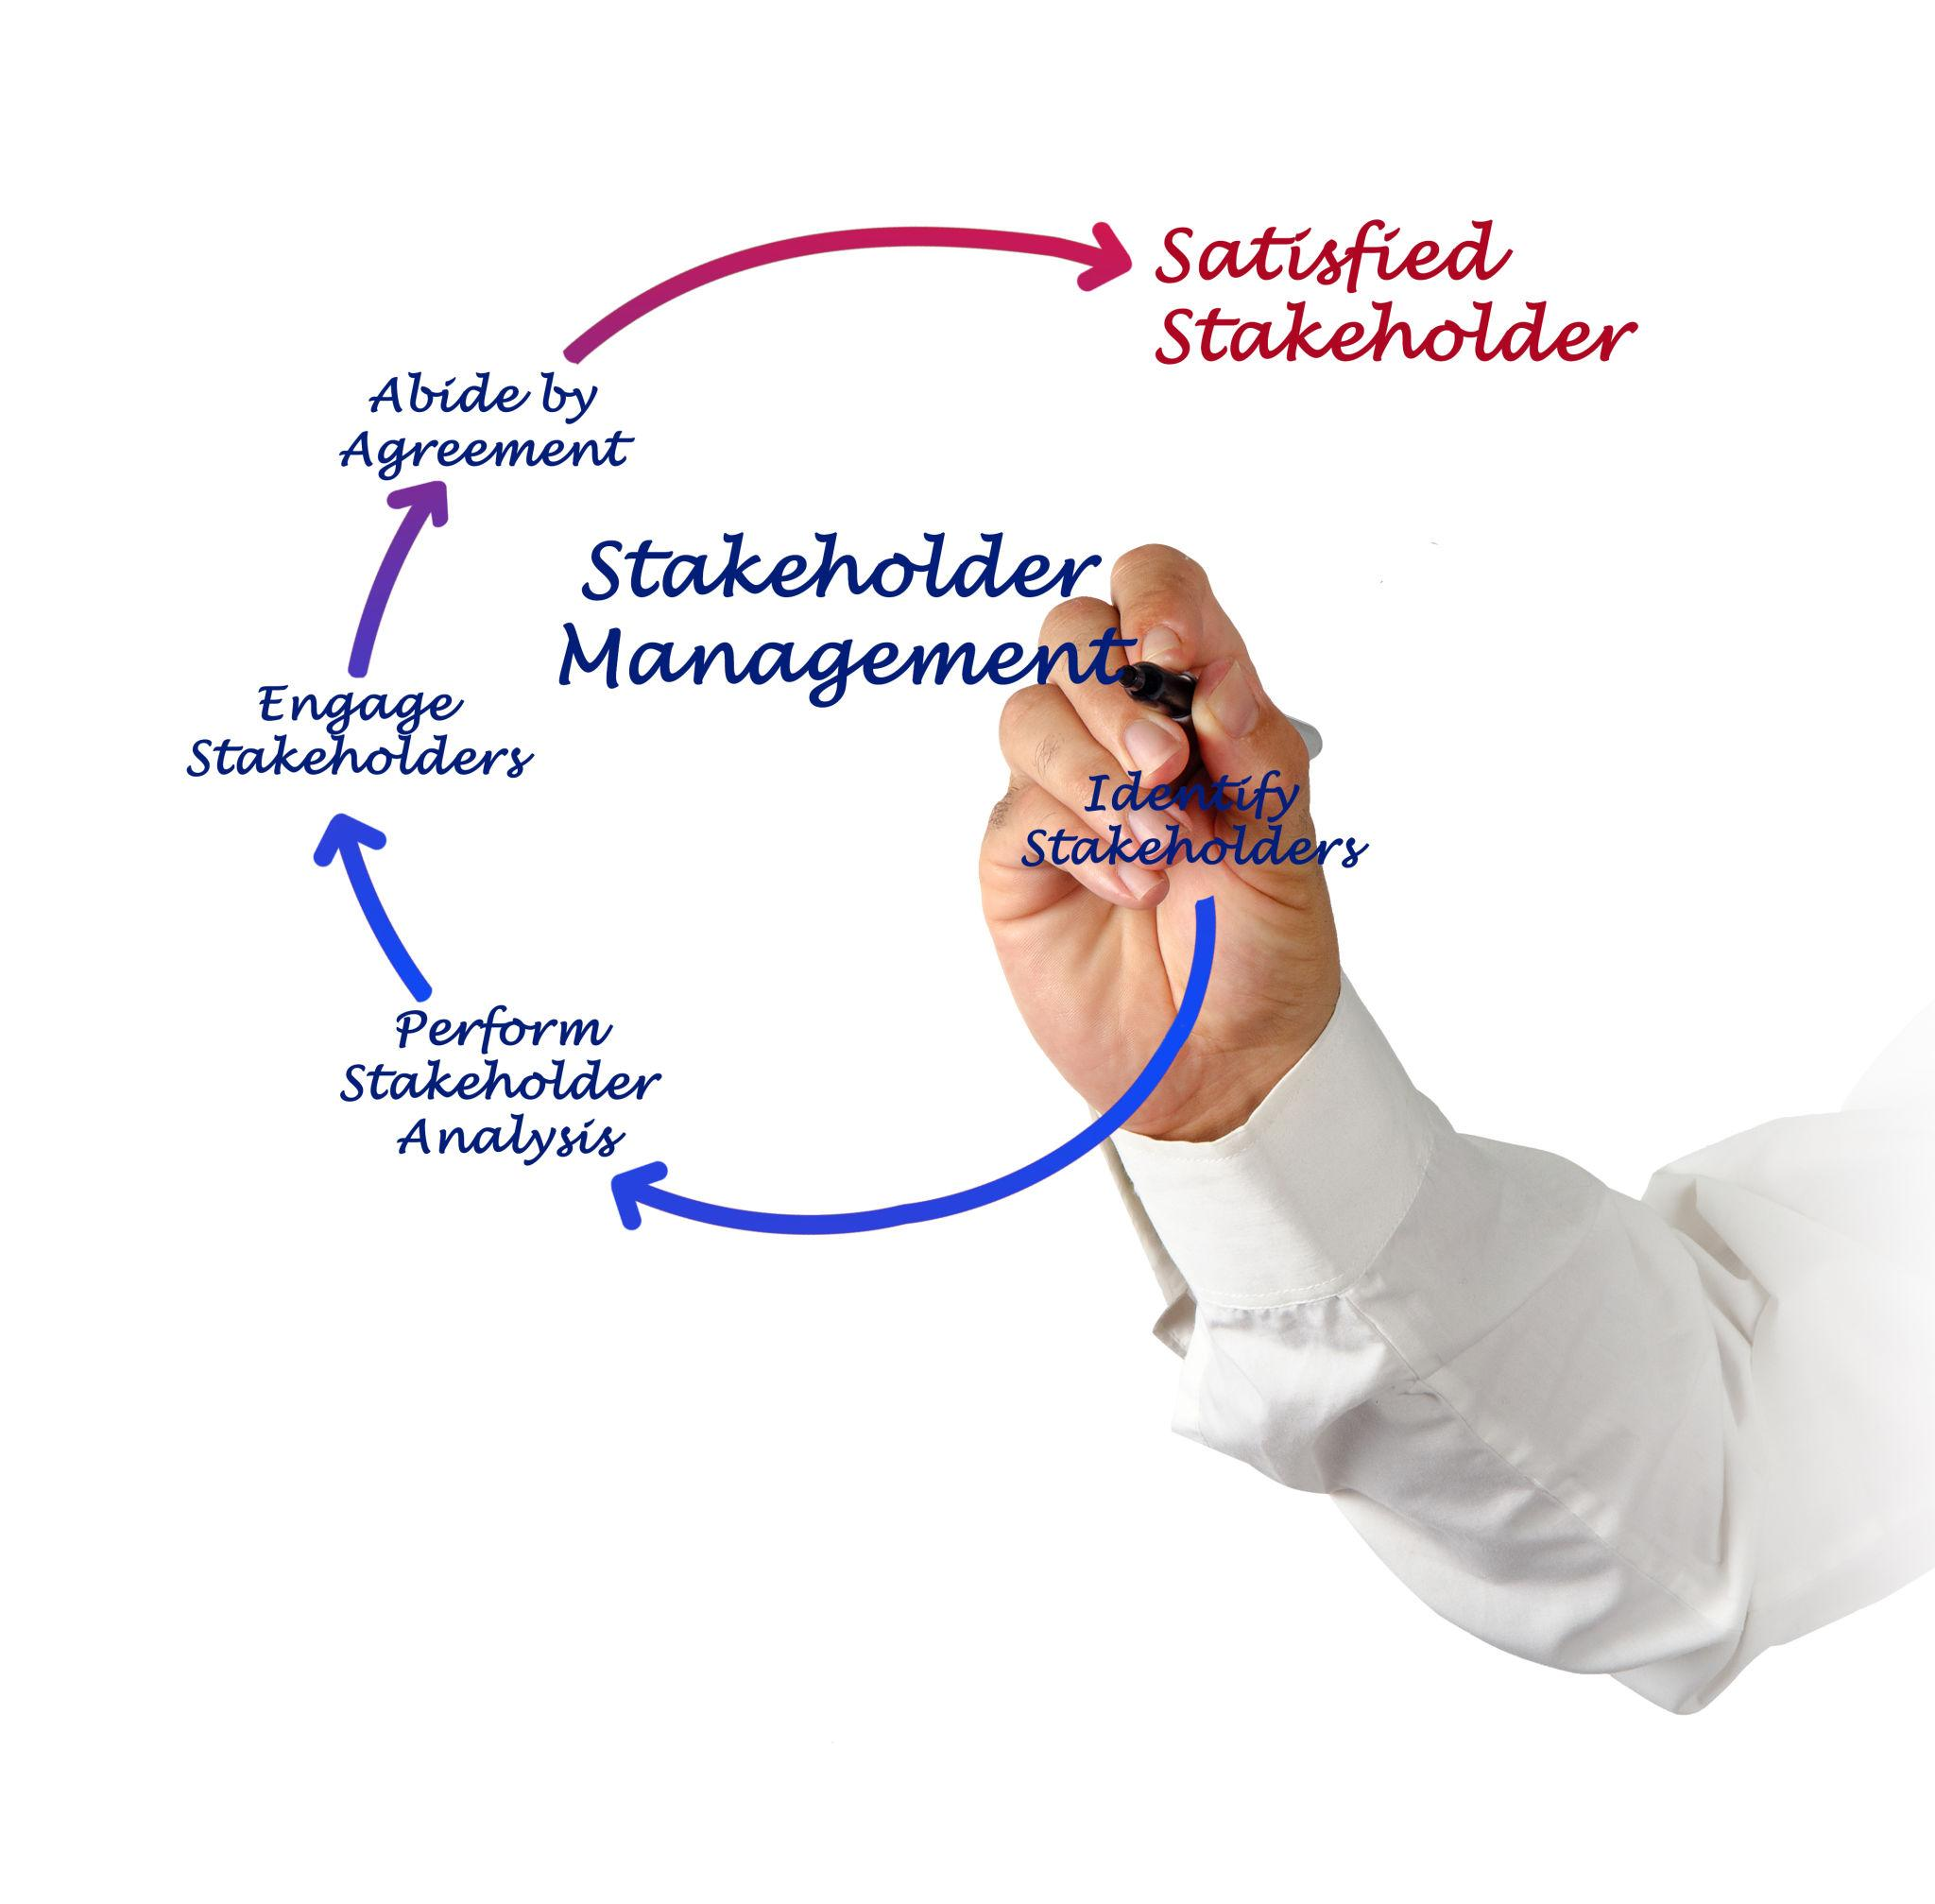
WHAT IS A STAKEHOLDER?
📌 Simple Definition
Anyone affected by the project OR anyone who can influence it.
Pakistan Examples
Product Owner at Systems Limited
Client (REI Blackbook style scenario)
Government regulators (PTA in telecom)
Customers using Daraz or Careem
International Examples
Uber drivers
Netflix subscribers
Microsoft enterprise clients

Slide 5
TYPES OF STAKEHOLDERS
🟢 Internal Stakeholders
These are people inside the organization who help deliver the product.
Examples:
Developers
Designers
QA
PM
CEO
Pakistan Case: Jazz internal product teams.
🔵 External Stakeholders
These people may not build the product but heavily influence success. Examples:
Customers
Vendors
Partners
Government
International Case: Amazon sellers are external stakeholders.

Slide 6
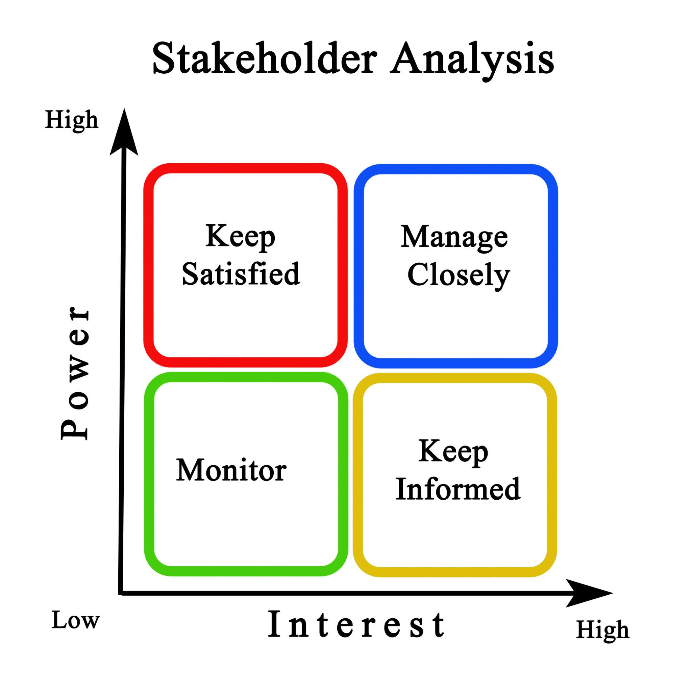
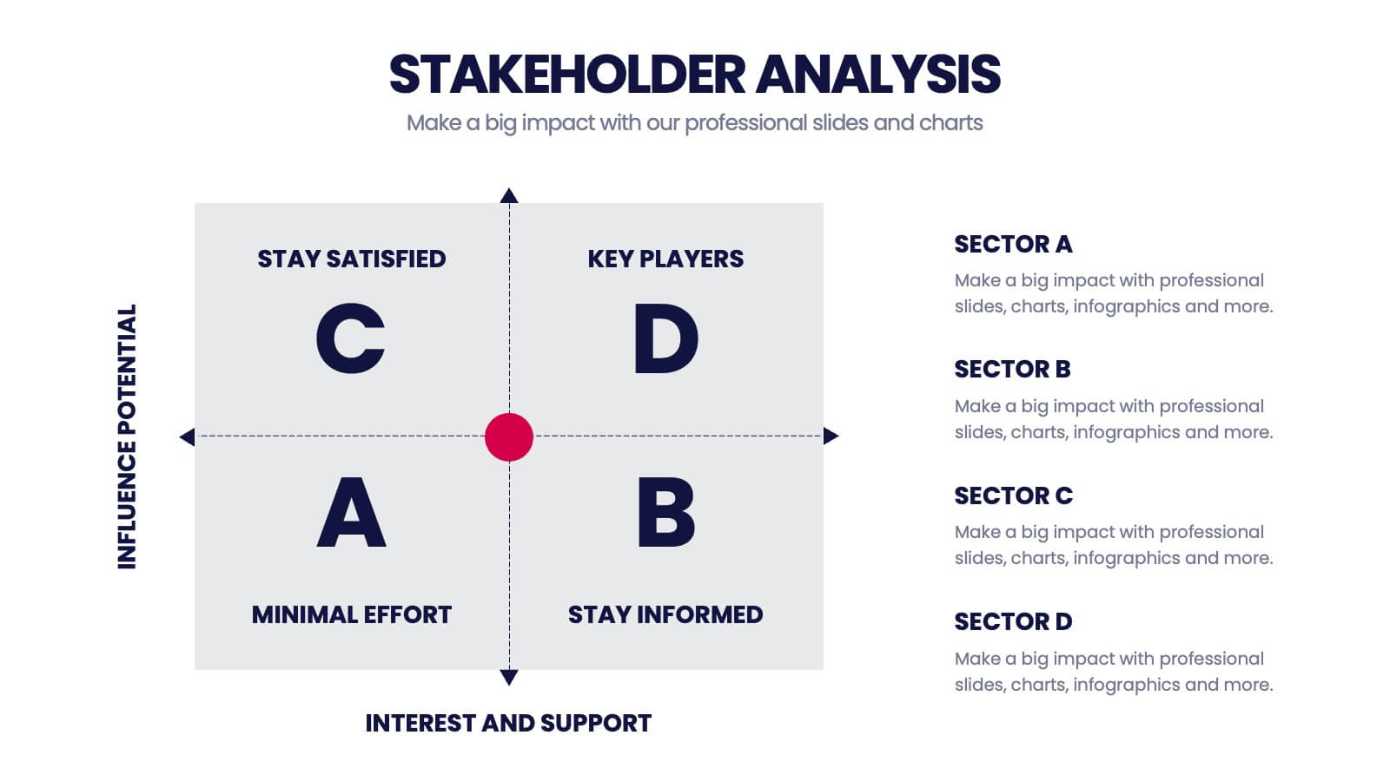
POWER–INTEREST MATRIX
OR

Slide 7
POWER–INTEREST MATRIX
🔴 Manage Closely (High Power + High Interest)
Examples:
Client CEO
Product Owner
Sponsor
.
👉 BA Action: Daily updates, frequent meetings.
🟠 Keep Satisfied (High Power + Low Interest)
Examples:
Finance Department
Legal Team
.
👉 BA Action: Monthly summaries.
🟡 Keep Informed (Low Power + High Interest)
Examples:
Developers
QA team
.
👉 BA Action: Sprint meetings, demos.
🟢 Monitor (Low Power + Low Interest)
Examples:
Casual observers
Non-core departments
.
👉 BA Action: Minimal communication.

Slide 8
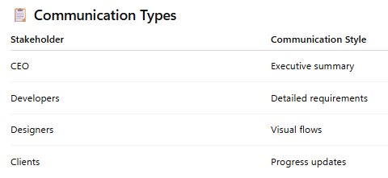
COMMUNICATION PLANNING
A Business Analyst spends 50–70% time communicating.
Pakistan Example – Realistic Scenario
Client says:
“Why is feature late?”
BA must:
Explain dependencies
Translate technical issues into business language

Slide 9
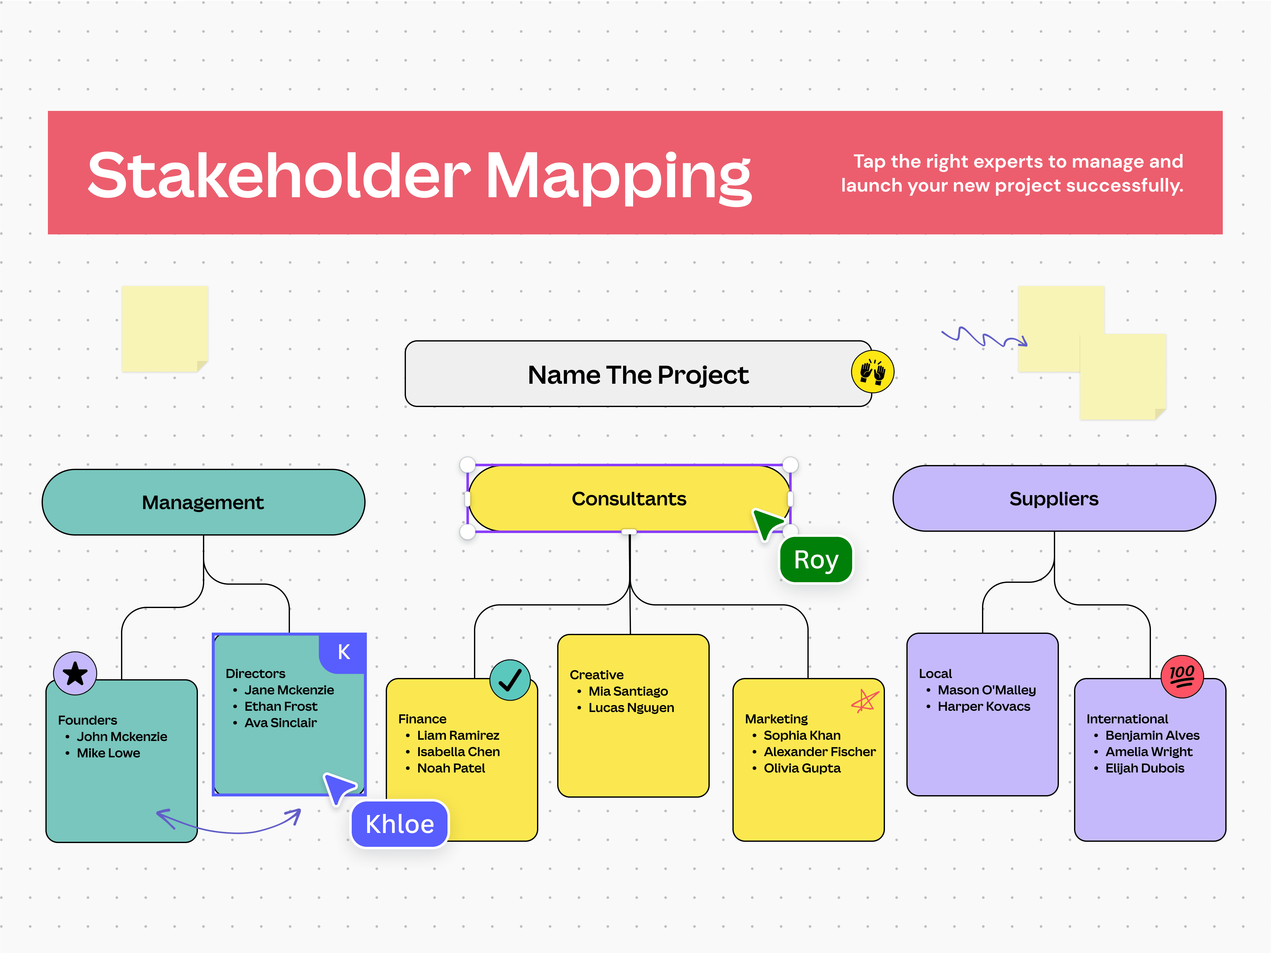
COMMUNICATION PLANNING

Slide 10

CONFLICT MANAGEMENT
Conflict is NORMAL in projects.
Common conflicts:
Business vs Tech priorities
Design vs Development
Client vs Delivery team
🔴 Pakistan Industry Example
Real estate CRM project:
Client wants daily changes → Developers stressed.
BA Role:
Document requirements clearly
Set expectation boundaries
🧠 Conflict Resolution Techniques
4 simple methods:
✔ Listen actively : “Don’t defend immediately — understand first.” ✔ Reframe problem in business terms — “What outcome are we trying to achieve?” ✔ Use data instead of emotion — “Numbers reduce emotional debates.” ✔ Document decisions — “This protects the team later.”

Slide 11
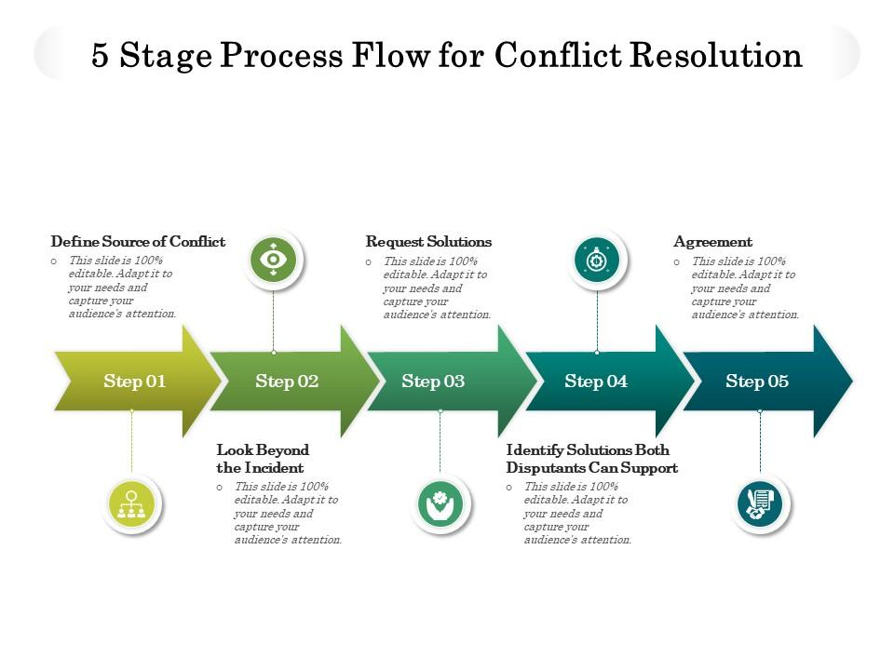
CONFLICT MANAGEMENT

Slide 12
Classroom Discussion (5 Minutes)
Scenario:
Careem introduces a new pricing model.
Stakeholders:
Customers angry
Finance happy
Marketing confused
👉 “Who should the BA prioritize first?”
Most escalations happen because expectations were unclear — not because teams failed.

Slide 13
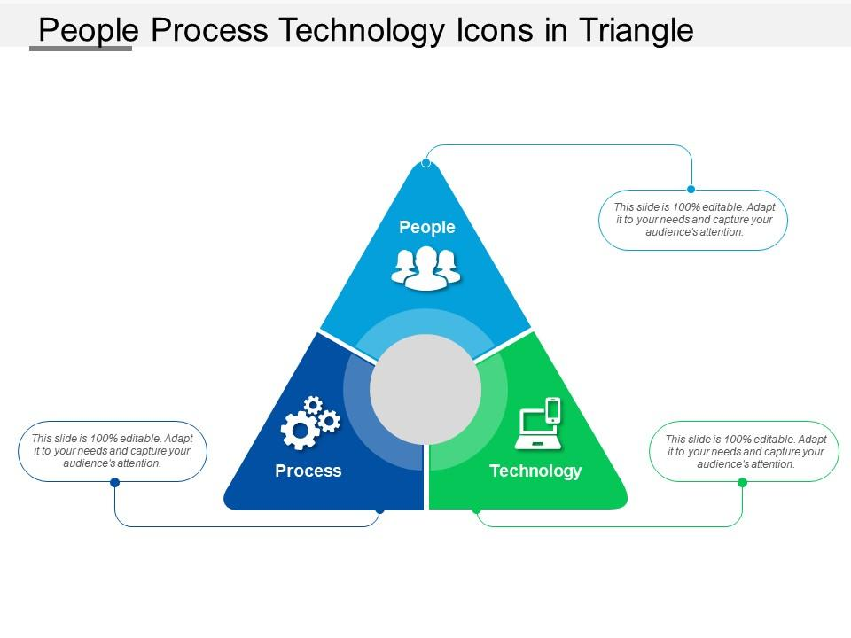
BA TRIANGLE DIAGRAM
A BA stands at the intersection — balancing expectations.

Slide 14
“Many escalations I’ve seen were caused by unclear stakeholder ownership.”
“Design delays often happen when stakeholders are not aligned early.”
“A strong BA prevents problems before they reach management.”

